Slide 1
Presentation on:
Hospital management system

Slide 2
Team member:
1.Joy Adhikary
Id:18192103062 Supervised By:
2.Oleraj Hossin Md.Saifur Rahman
Id:18192103072 Assistant Professor
3.Pallab Majumdar Department of CSE(BUBT)
Id:18192103050

Slide 3
Index
Introduction
1. Purpose
2. Scope
3. Motivation
4. Objective of project
Main system design
Flow chart
Conclusion
1. Sample code of project
2. Sample screenshot of project
3. Limitation
4. Future work
5. Reference

Slide 4
Purpose
• The Software is for the automation of Hospital Management.
• It maintains two levels of users:-
Administrator Level
User Level
• The Software includes:-
Maintaining Patient details.
Providing Prescription.
Billing and Report generation.

Slide 5
scope
It can be used in any Hospital, Clinic, Dispensary or Pathology labs for maintaining patient details and their test results.

Slide 6
Motivation
Our respected course instructor Assistant professor Md. Saifur Rahman, Department of CSE, Bangladesh University of Business & Technology (BUBT). He first motivates us to create any type of management project. Then we discuss with our team member and decide to develop a Hospital Management System.

Slide 7
Objective of project
Design a system for better patient care.
Reduce hospital operating costs.
Better co-ordination among the different departments.
Provide top management a single point of control.

Slide 8
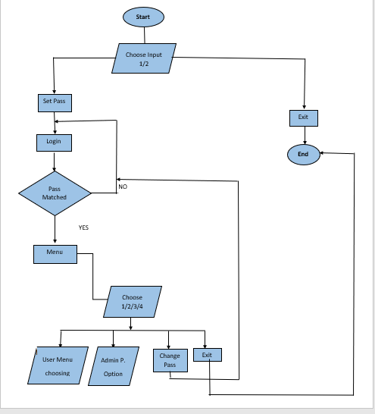
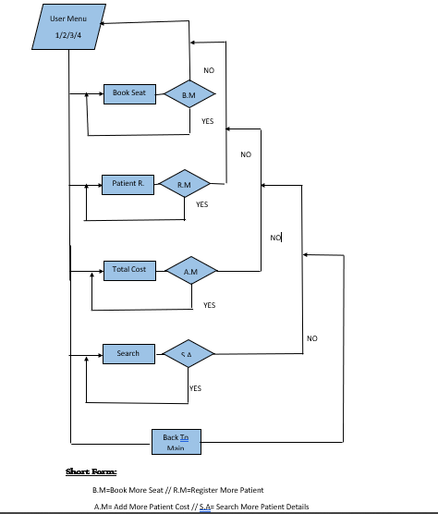
Follow Chart

Slide 9
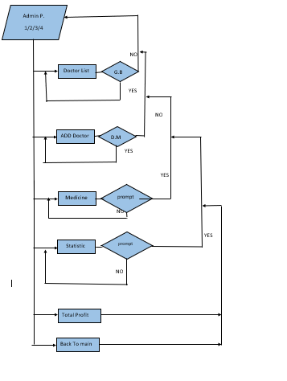

Slide 10
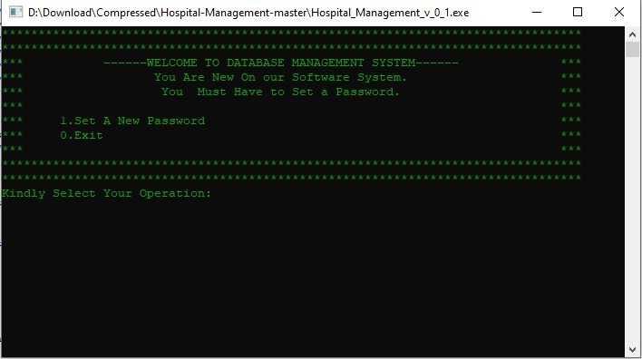
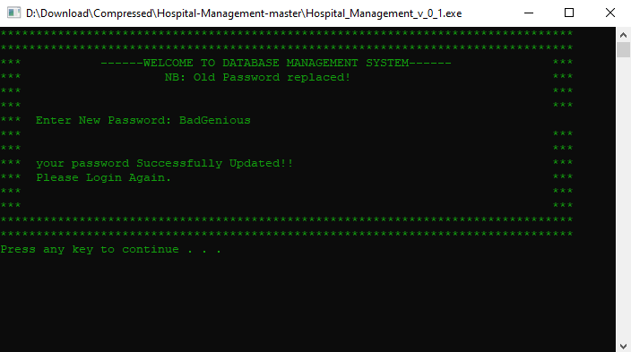
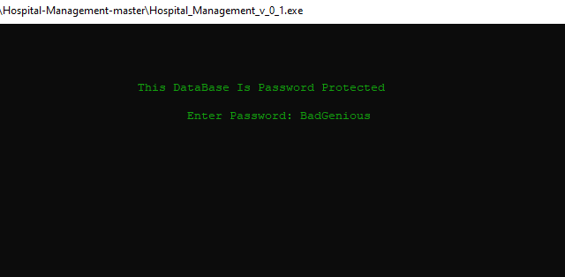
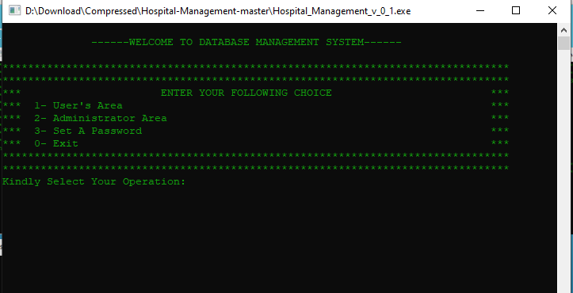
Screenshot Of Project

Slide 11
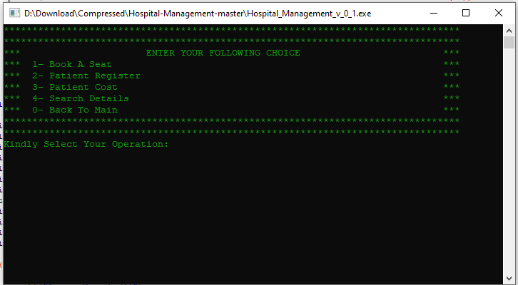
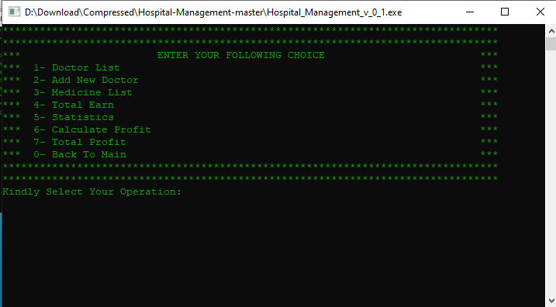
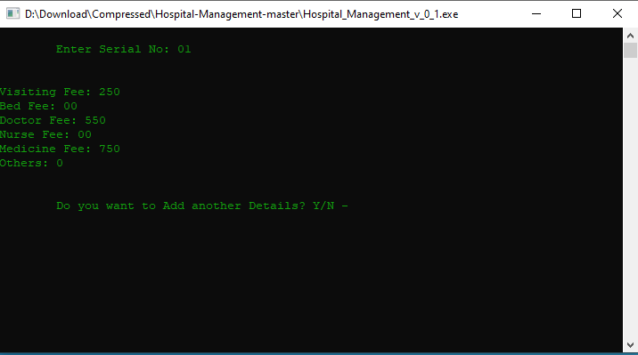
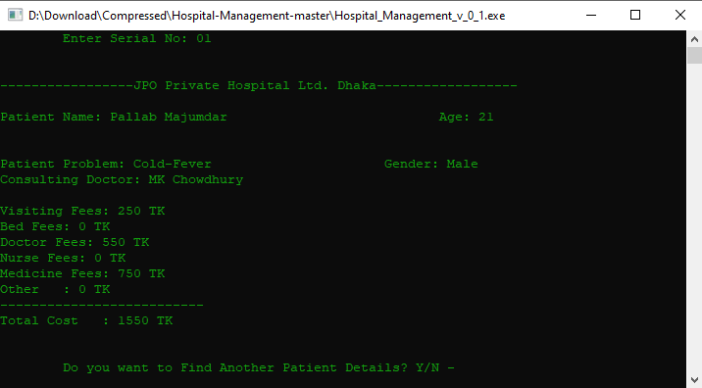

Slide 12
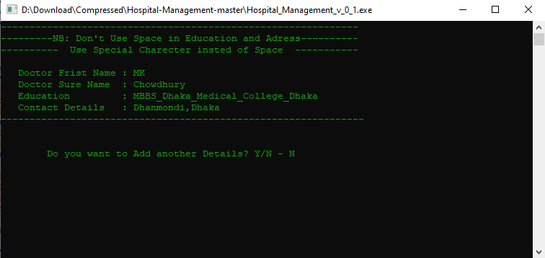
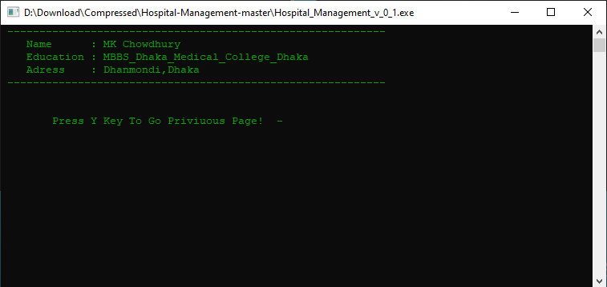
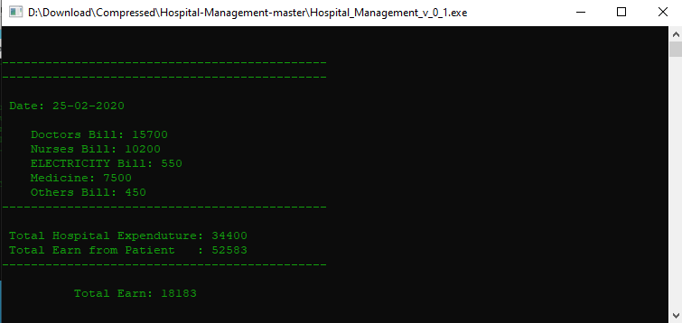
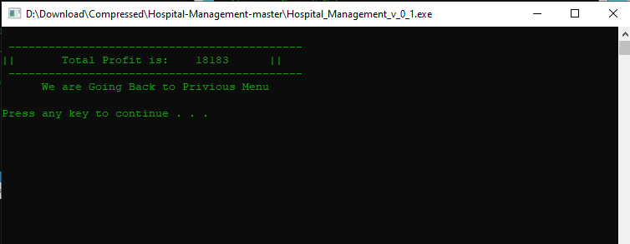

Slide 13
Limitation
Medicine List is Build-in Added. No one can Add New invented Medicine.
String ( Patient Name,Doctor Name) can take only two word if we separate them with space.
After Changing Or After set a password, Login in process Show Access denied for Frist time then it work smoothly.

Slide 14
Future work
Custom Medicine Adding system will be added on future , when Clinet Will request for that. Its a Business Trick.
Login in Bug will be fixed on Future Update.
String Problem also be fixed on future work.
We will also add some feature “How much medicine Have left after selling, Which doctor are free to Treate ment,Doctor Earning list etc” in Future udate.
We will secure our software in future.

Slide 15
Thanks to everyone

